Slide 1
Project Management
3
Systems Analysis and Design,
Kendall & Kendall

Slide 2
Project Management Fundamentals
Initiating Project
Determining project feasibility
Ascertaining Hardware and Software Needs
Activity planning and control
Project scheduling
Managing systems analysis team members
Kendall & Kendall
3-<number>
Notes:
Project initiation – begins with problems or with opportunities for improvement in a business as the organization adapts to change.
Determining project feasibility – need to work with decision makers to determine if it is feasible.
Project scheduling – project activities are scheduled through the use of tools such as Gantt charts and PERT diagrams.
Planning and managing activities and team members – part of assuring the productivity of systems analysis team members is effectively managing scheduled activities.

Slide 3
Initiating Project
Problems in the organization
  Problems that lead themselves to systems solutions
Opportunities for improvement
  Caused through upgrading, altering, or installing new systems
Kendall & Kendall
3-<number>
Notes:
Both problems and opportunities can arise as the organization adapts to and copes with natural, evolutionary change.

Slide 4
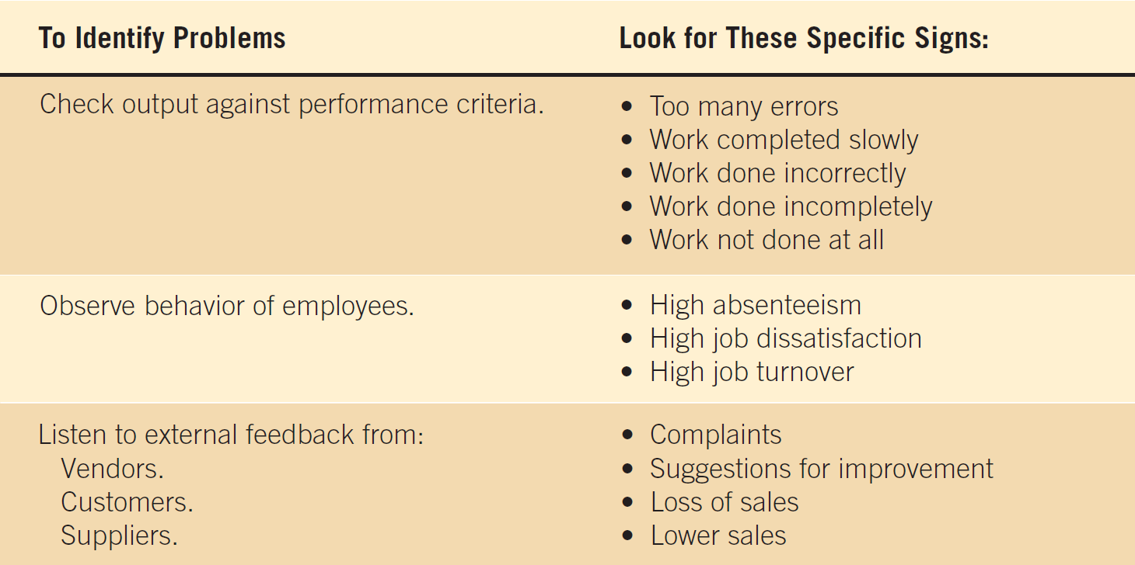
Figure 3.1 Checking output, observing employee behavior, and listening to feedback are all ways to help the analyst pinpoint systems problems and opportunities
Kendall & Kendall
3-<number>

Slide 5
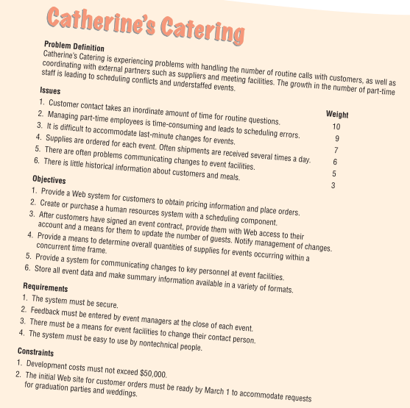
Kendall & Kendall
3-<number>

Slide 6
Determining Feasibility
Defining objectives
Determining resources
  Operationally
  Technically
  Economically
Kendall & Kendall
3-<number>
Notes:
The feasibility study must be highly time compressed, encompassing several activities in a short span of time.

Slide 7
Defining Objectives
Many possible objectives exist including:
  Speeding up a process
  Streamlining a process
  Combining processes
  Reducing errors in input
  Reducing redundant storage
  Reducing redundant output
  Improving system and subsystem integration
Kendall & Kendall
3-<number>
Notes:
Improvements to systems can be defined as changes that will result in incremental but worthwhile benefits.

Slide 8
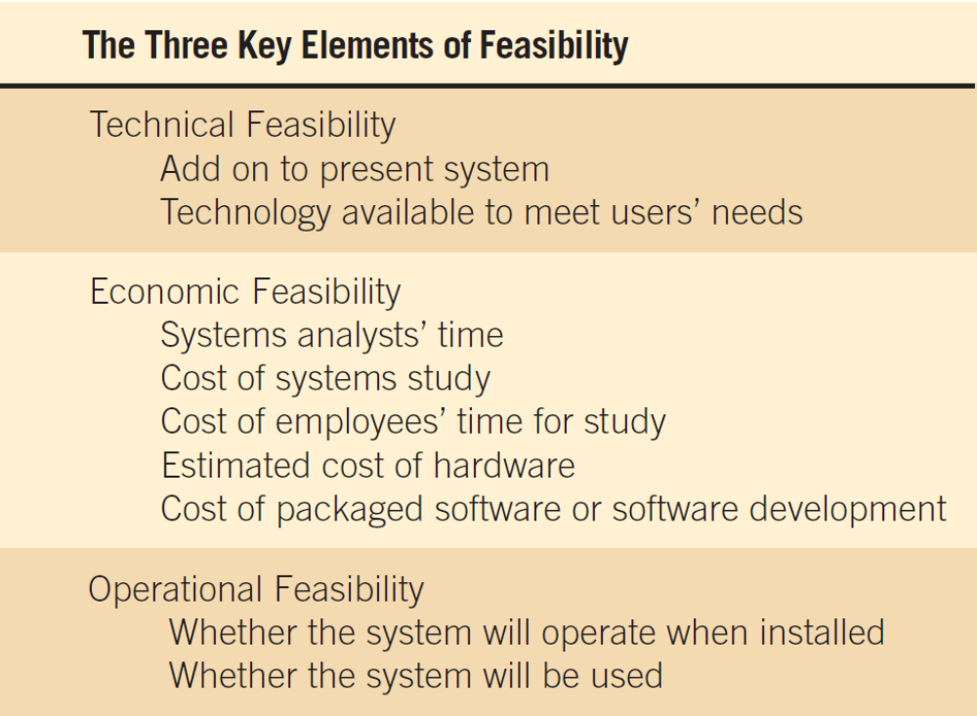
Figure 3.5 The three key elements of feasibility include technical, economic, and operational feasibility
Kendall & Kendall
3-<number>
Notes:
A project must be feasible in all three ways to merit further development.

Slide 9
Technical Feasibility
Can current technical resources be upgraded or added to in a manner that fulfills the request under consideration
If not, is there technology in existence that meets the specifications
Kendall & Kendall
3-<number>
Notes:
Sometimes add-0ns are costly and not worthwhile, because they meet needs inefficiently.

Slide 10
Economic Feasibility
Economic feasibility determines whether value of the investment exceeds the time and cost
Includes:
  Analyst and analyst team time
  Business employee time
  Hardware
  Software
  Software development
Kendall & Kendall
3-<number>
Notes:
If short-term costs are not overshadowed by long-term gains or produce no immediate reduction in operating costs, the system is not economically feasible.

Slide 11
Operational Feasibility
Operational feasibility determines if the human resources are available to operate the system once it has been installed
Users that do not want a new system may prevent it from becoming operationally feasible
Kendall & Kendall
3-<number>
Notes:
If users are satisfied with current system resistance to implementing a new system will be strong.
If users are dissatisfied with the current system and have expressed a need for change chances are that the new system will be used.

Slide 12
Ascertaining Hardware and Software Needs
Steps used to determine hardware and software needs:
    Inventory computer hardware currently available
    Estimate current and future system workloads
    Evaluate available hardware and software
    Choose the vendor
    Acquire the computer equipment
Kendall & Kendall
10-<number>
Notes:
Only when systems analysts, users, and management have a good grasp of what kinds of tasks must be accomplished can hardware options be considered.

Slide 13
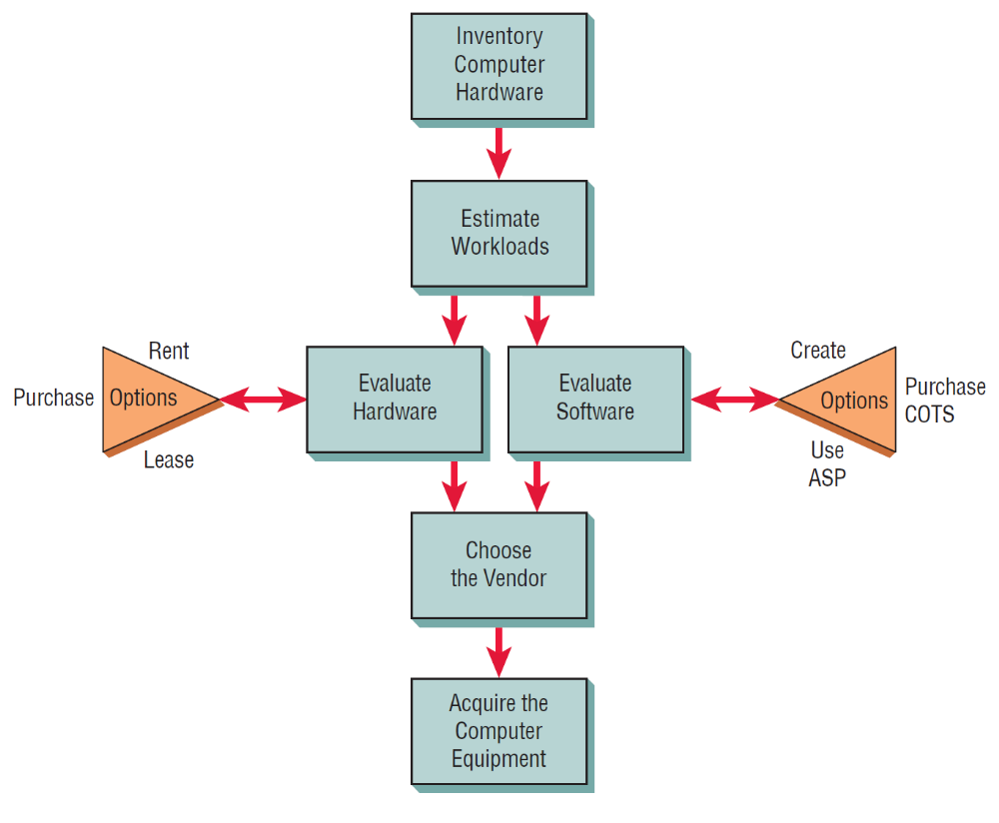
Figure 10.1 Steps in choosing hardware and software
Kendall & Kendall
10-<number>

Slide 14
Evaluating Hardware
Time required for average transactions
Total volume capacity of the system
Idle time of the CPU or network
Size of memory provided
Kendall & Kendall
10-<number>
Notes:
Criteria that the systems analysts and users should use to evaluate performance of different systems hardware:
Time required for average transactions – including how long it takes to input data and how long it takes to receive output.
Total volume capacity of the system – how much can be processed at the same time before a problem arises.
Idle time of the CPU or network
Size of memory provided

Slide 15
Acquisition of Computer Equipment
Buying
Leasing
Rental
Kendall & Kendall
10-<number>
Notes:
Influential factors:
Initial versus long-term costs.
Can capital afford to be tied up in computer equipment.
Should the business have full control of and responsibility for the computer equipment.

Slide 16
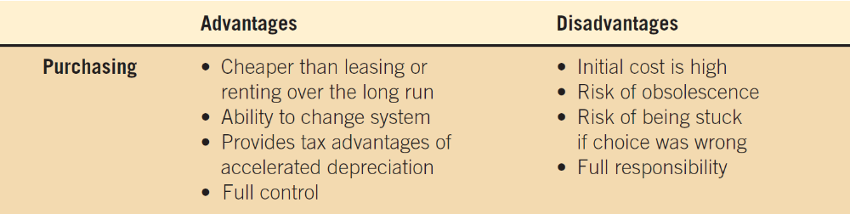
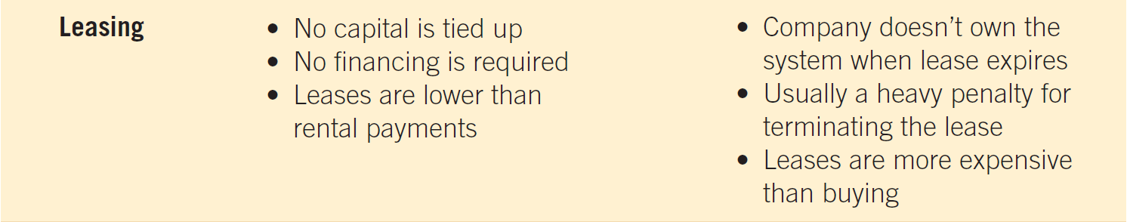
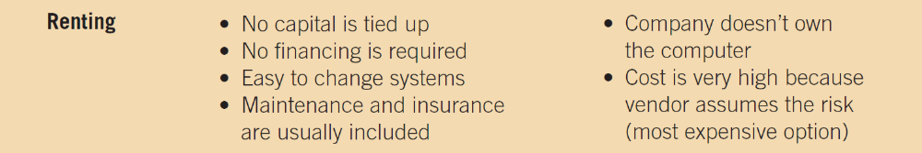
Buying
Kendall & Kendall
10-<number>
Notes:
Main determinants – projected life of the system.
As systems become smaller, more powerful, less expensive, and distributed systems become increasingly popular, more businesses are deciding to purchase equipment.

Slide 17
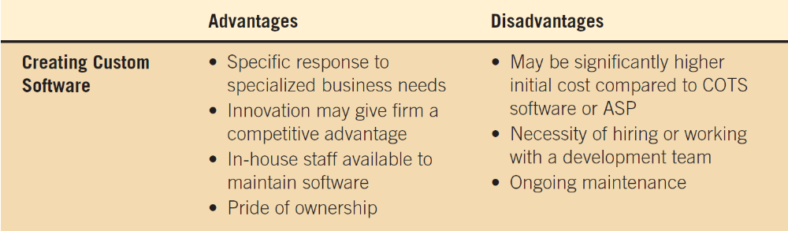
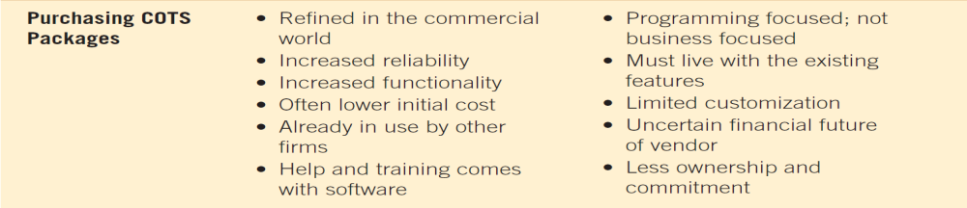
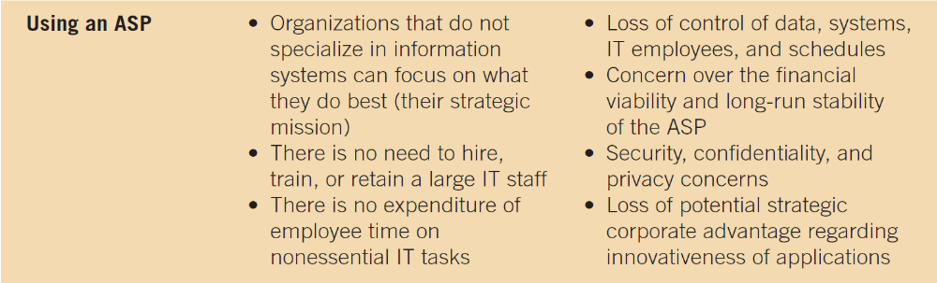
Creating Custom Software
Kendall & Kendall
10-<number>

Slide 18
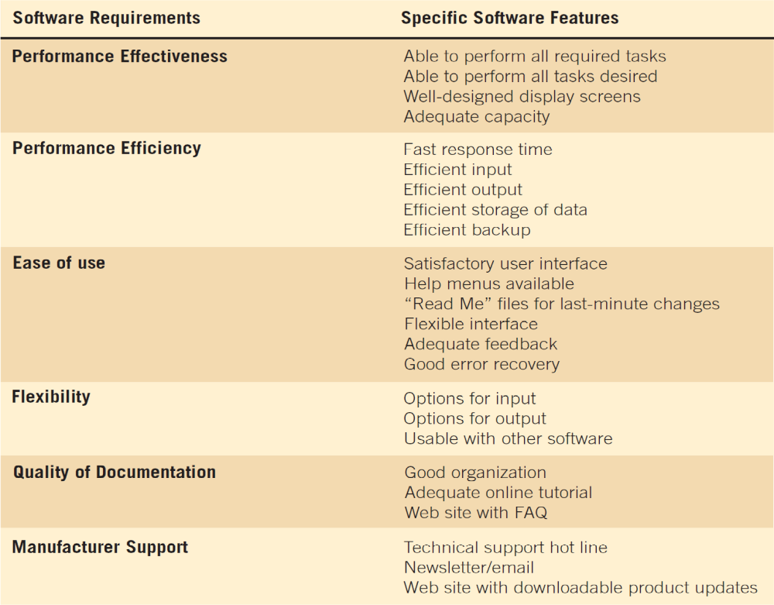
Figure 10.7 Guidelines for evaluating software
Kendall & Kendall
10-<number>
Notes:
Evaluate packaged software based on a demonstration with test data from the business considering it and an examination of accompanying documentation.

Slide 19
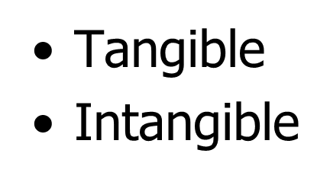
Forecasting Benefits and Costs
Historic Data
  Conditional
  Unconditional
Identifying Benefits and Costs
Kendall & Kendall
10-<number>

Slide 20
Tangible Benefits
Advantages measurable in dollars that accrue to the organization through the use of the information system
Examples:
  Increase in the speed of processing
  Access to otherwise inaccessible information
  Access to information on a more timely basis
  The advantage of the computer’s superior calculating power
  Decreases in the amount of employee time needed to complete specific tasks
Kendall & Kendall
10-<number>
Notes:
Tangible benefits can be measured in terms of dollars, resources, or time saved.

Slide 21
Intangible Benefits
Intangible benefits are benefits from use of the information system that are difficult to measure
Examples:
  Improving the decision-making process
  Becoming more competitive in customer service
  Maintaining a good business image
  Increasing job satisfaction
Kendall & Kendall
10-<number>
Notes:
Both tangible and intangible benefits must be discussed in the proposal, both will allow decision makers to make a well-informed decision about the proposed system.

Slide 22
Tangible Costs
Those that can be accurately projected by systems analysts and the business’ accounting personnel
Examples:
  Cost of equipment
  Cost of resources
  Cost of systems analysts' time
  Cost of programmers’ time
  Employees’ salaries
Kendall & Kendall
10-<number>
Notes:
These costs are well established and are the costs that require a cash outlay of the business.

Slide 23
Intangible Costs
Those that are difficult to estimate, and may not be known
Examples:
  Losing a competitive edge
  Losing the reputation
  Declining company image
  Ineffective decision making
Kendall & Kendall
10-<number>
Notes:
It is generally not possible accurately to project a dollar amount for intangible costs.

Slide 24
Comparing Costs and Benefits
Break-even analysis
Payback
Cash-flow analysis
Present value analysis
Kendall & Kendall
10-<number>
Notes:
All these techniques provide straightforward ways of yielding information to decision makers about the worthiness of the proposed system.

Slide 25
Break-Even Analysis
The point at which the total cost of the current system and the proposed system intersect
Useful when a business is growing and volume is a key variable in costs
Disadvantage
  Benefits are assumed to remain the same
Advantage
  Can determine how long it will take for the benefits of the system to pay back the costs of developing it
Kendall & Kendall
10-<number>
Notes:
Total costs = costs that recur during operation of the system + developmental costs that occur only once

Slide 26
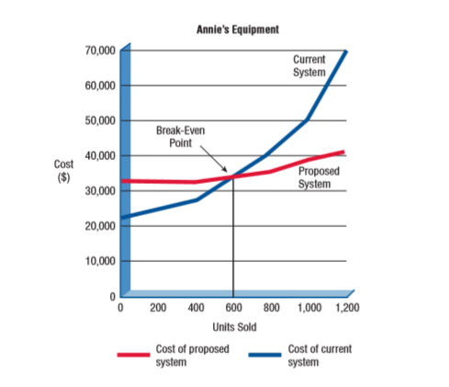
Break Even Analysis
Kendall & Kendall
3-<number>

Slide 27
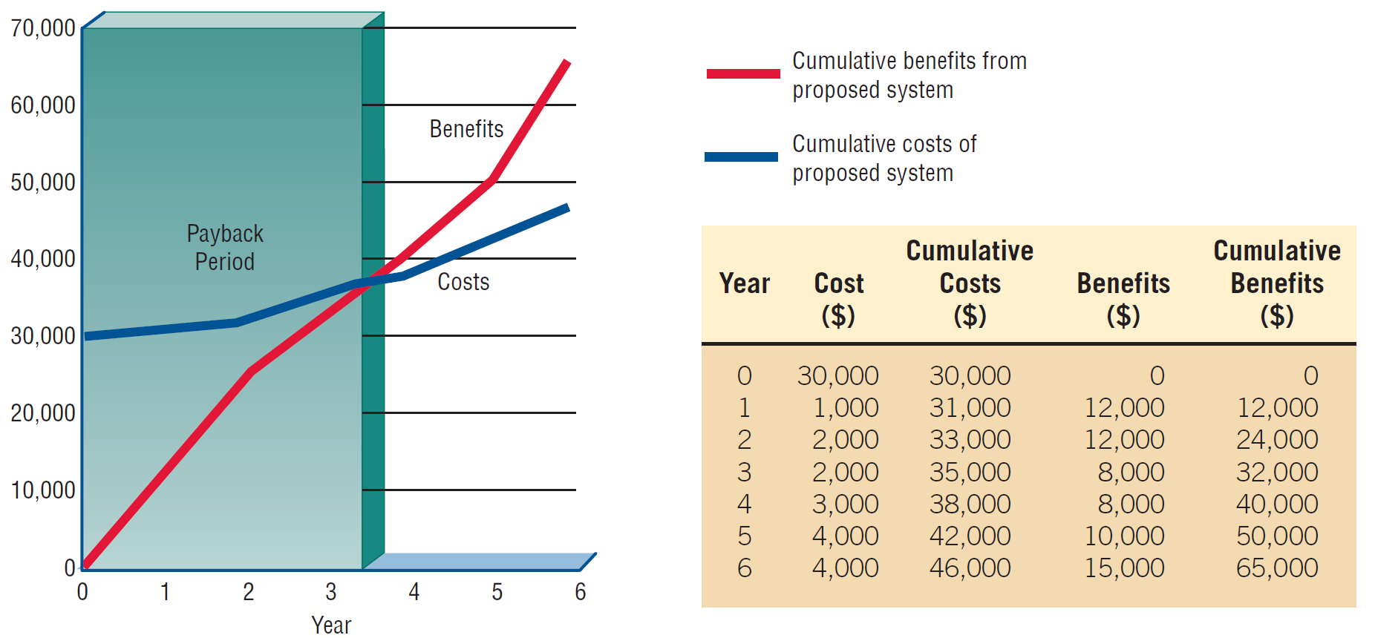
Figure 10.13 Break-even analysis showing a payback period of three and a half years
Kendall & Kendall
10-<number>

Slide 28
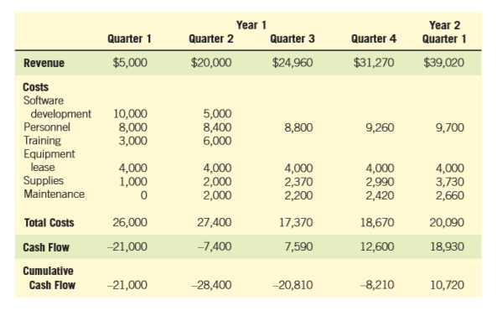
Cash-Flow Analysis
Kendall & Kendall
3-<number>

Slide 29
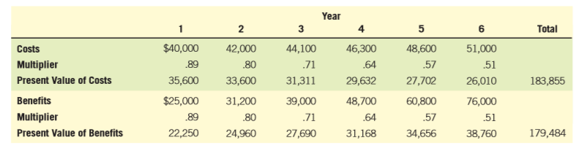
Present Value Analysis
Kendall & Kendall
3-<number>

Slide 30
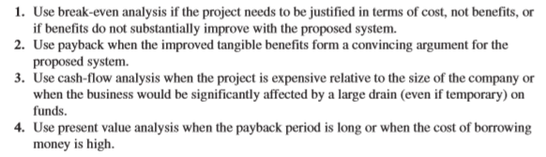
Guidelines for Analysis
Kendall & Kendall
3-<number>
Notes:
Present value = payback period long
Cash flow = project huge in terms of size
Payback = Tangible benefits
Break-even = justified in terms of cost not benefit

Slide 31
Activity Planning And Control
Planning includes:
  Selecting a systems analysis team
  Estimating time required to complete each task
  Scheduling the project
Control includes:
  Comparing the plan for the project with its actual evolution
  Taking appropriate action to expedite or reschedule activities
Kendall & Kendall
3-<number>

Slide 32
Estimating Time
Project is broken down into phases.
Further project is broken down into tasks or activities
Finally project is broken down into steps or even smaller units
Time is estimated for each task or activity
Most likely, pessimistic, and optimistic estimates for time may be used
Kendall & Kendall
3-<number>

Slide 33
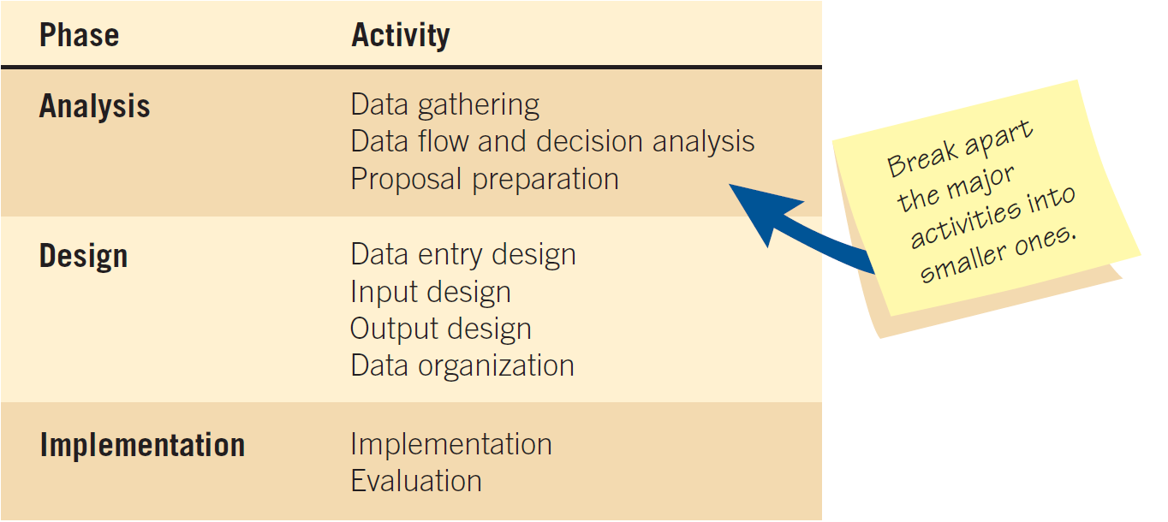
Figure 3.6 Beginning to plan a project by breaking it into three major activities
Kendall & Kendall
3-<number>

Slide 34
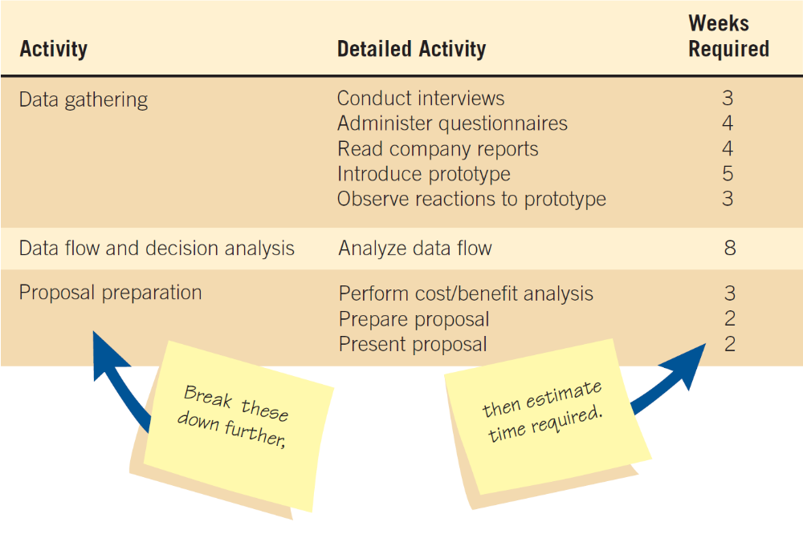
Figure 3.7 Refining the planning and scheduling of analysis activities by adding detailed tasks and establishing the time required to complete the tasks
Kendall & Kendall
3-<number>

Slide 35

Project Scheduling
Gantt Charts
  Simple
  Lends itself to end user communication
  Drawn to scale
PERT diagrams
  Useful when activities can be done in parallel
Kendall & Kendall
3-<number>

Slide 36
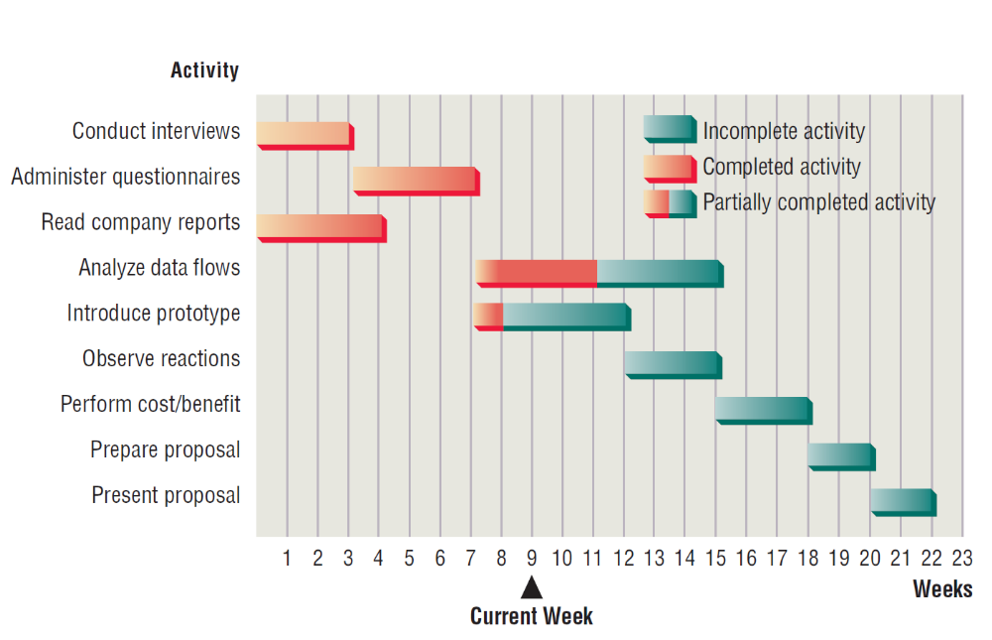

Figure 3.8 Using a two-dimensional Gantt chart for planning activities that can be accomplished in parallel
Kendall & Kendall
3-<number>

Slide 37
PERT Diagram
Scheduling based on sequence of activities
PERT Diagrams with dummies
Identifying Critical Path
Kendall & Kendall
3-<number>

Slide 38
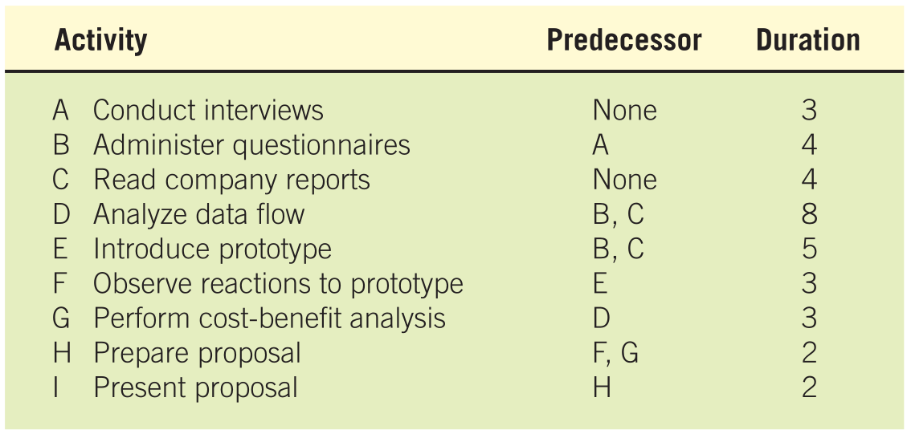


PERT Diagram
Kendall & Kendall
3-<number>

Slide 39
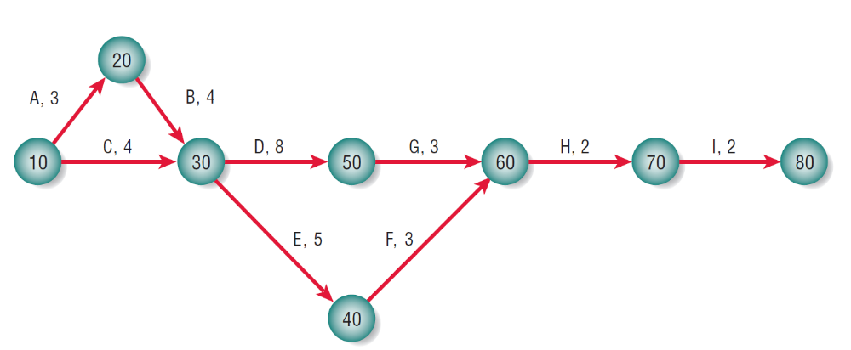
Figure 3.12 A completed PERT diagram for the analysis phase of a systems project
Kendall & Kendall
3-<number>

Slide 40
PERT Diagram Advantages
Easy identification of the order of precedence
Easy identification of the critical path and thus critical activities
Kendall & Kendall
3-<number>

Slide 41
Project Failures
Project failures may be prevented by:
  Training
  Experience
  Learning why other projects have failed
Project charter
  Describes in a written document what the expected results of the systems project are and the time frame for delivery
Kendall & Kendall
3-<number>

Slide 42
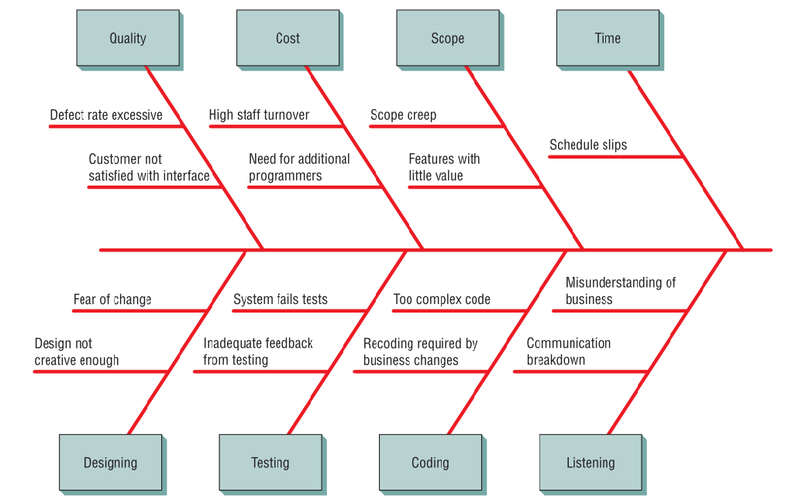

Kendall & Kendall
3-<number>

